Slide 1
XTANT
Company Naming and Branding Presentation
EXTANT /ek ·stant/ (adj)
archaic: standing out or above
Resilient, still standing

Slide 2
NAMING

Slide 3
2
XTANT MEDICAL SYSTEMS
Rationale behind the name change
XTANT Medical Systems has been chosen as the merged parent company name of Bacterin and X-spine. This name was designed to portray both companies in the Biologics and Hardware market space. By definition, extant means to stand out or above which we believe our company will represent in the market. The ‘E’ has been dropped from the company name in order to differentiate ourselves from the TV show Extant, thus increasing value in online marketing campaigns. Medical Systems demonstrates good visibility with the investor community and provides the option of acquiring additional sub companies.

Slide 4
STRATEGY

Slide 5
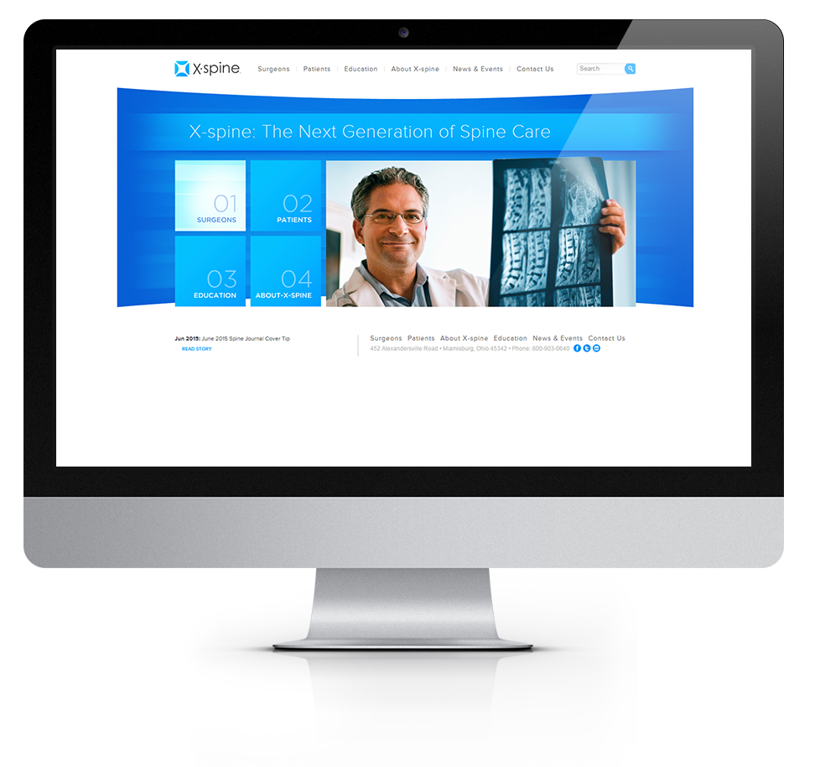
XTANT MEDICAL SYSTEMS
Rebranding Process Outline
Logo competitor analysis of similar combined companies
Adoption of colors from X-spine
Graphic Design creates multiple logo options using competitor analysis and overall definition of the company name
Marketing will narrow options to top 3 logos which best represent the new company goal
Top 3 logos will be reviewed by CEO, Marketing, and option of X-spine input
Each logo will be accompanied by a business card design, homepage mock-up, and displayed on various background colors (black logo on white background, white logo on black background).
Top logo design will be put into a brand identity guide which will include font, color, and positioning.
Additional materials will be created using the new logo

Slide 6
Why So Blue?
Joe Hallock’s Colour Assignment Study found clear favorite colors for both male and female audiences. Blue was a staggering favorite for both genders, preferred by 57% of men, and 35% of women.
Top 3 designs presented and top design is selected
Brand Identity Guide created
XTANT BRANDING
The roadmap for rebranding
Graphic Design creates multiple logo options
Additional materials and branding of company
Colors are adopted/selected
Logo Competitor Analysis

Slide 7
COLORS

Slide 8
COLOR PALLETE
Blues and Grays
Blue evokes feelings of calmness and spirituality as well as security and trust. Seeing the color blue causes the body to create chemicals that are calming. It is no surprise that it's the most favored of the colors. Light blues give a more relaxing, friendly feel. Great examples are social sites like Facebook and Twitter who use lighter blues.
- Allison Stuart, 99 Designs

Slide 9
LOGOS

Slide 10
VERSION 1

Slide 11
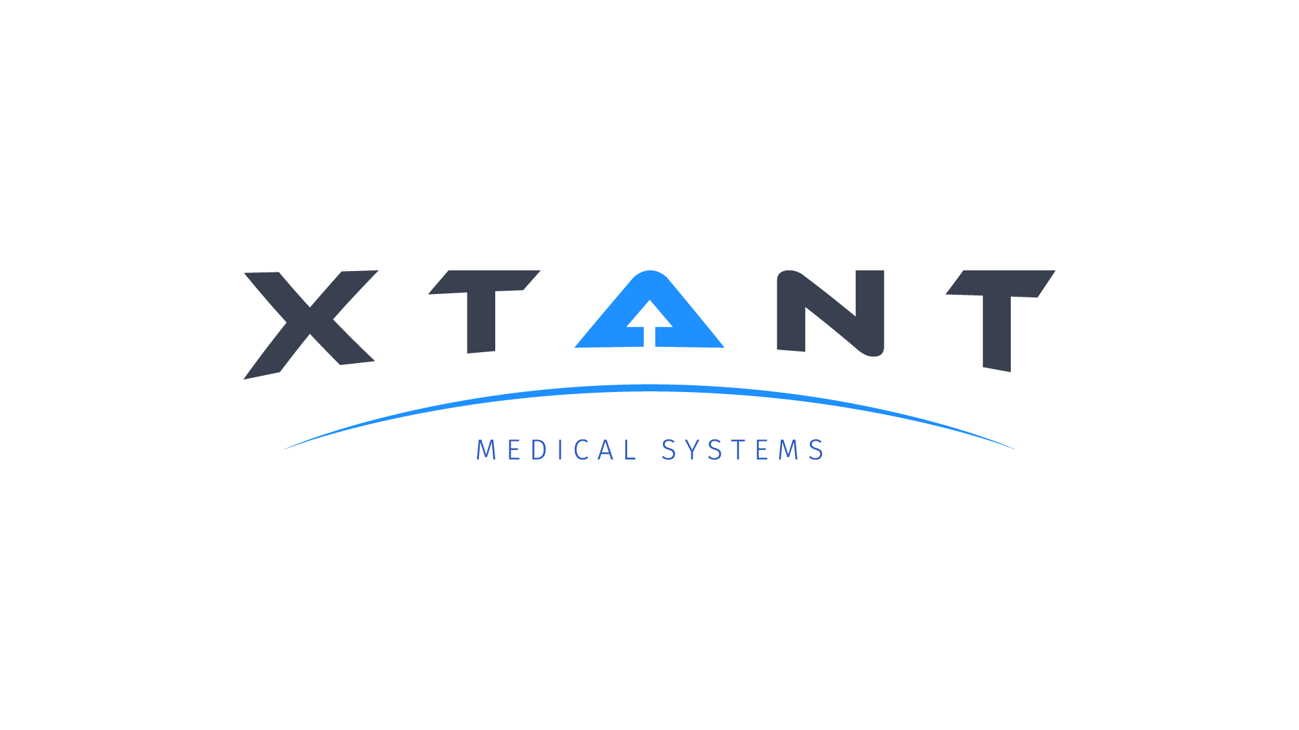
LOGOS
Version 1

Slide 12
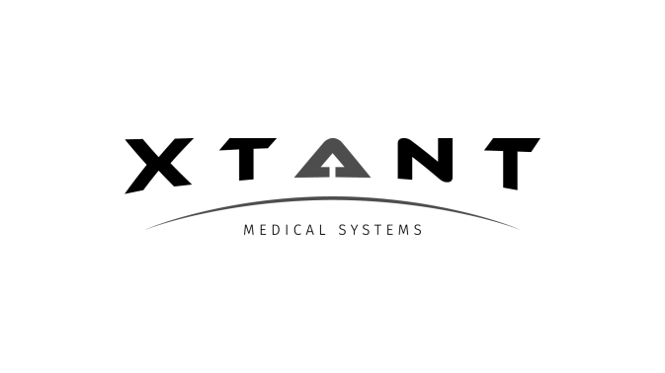
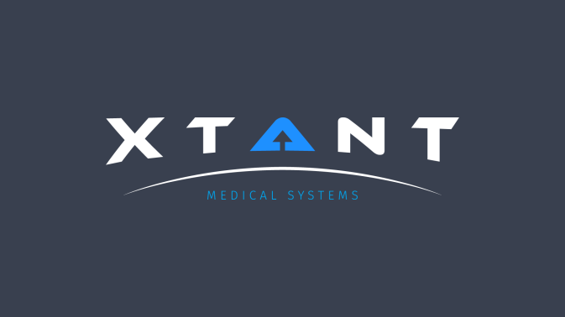
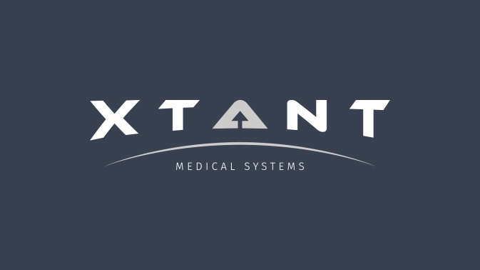
LOGOS
Version 1
Version 1 – Color on Light
Version 1 – Grayscale on Light
Version 1 – Color on Dark
Version 1 – Grayscale on Dark
This logo iteration does a great job of encompassing the definition of EXTANT. The use of negative space to create the up arrow above the horizon line is metaphoric for company goals and ambitions, while literally portraying ‘above and beyond’. This logo feels balanced and creates a sense of motion.

Slide 13
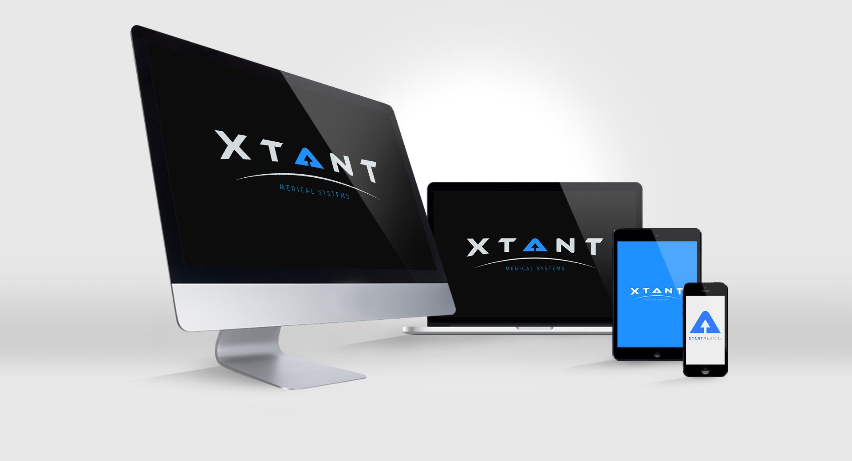

Slide 14
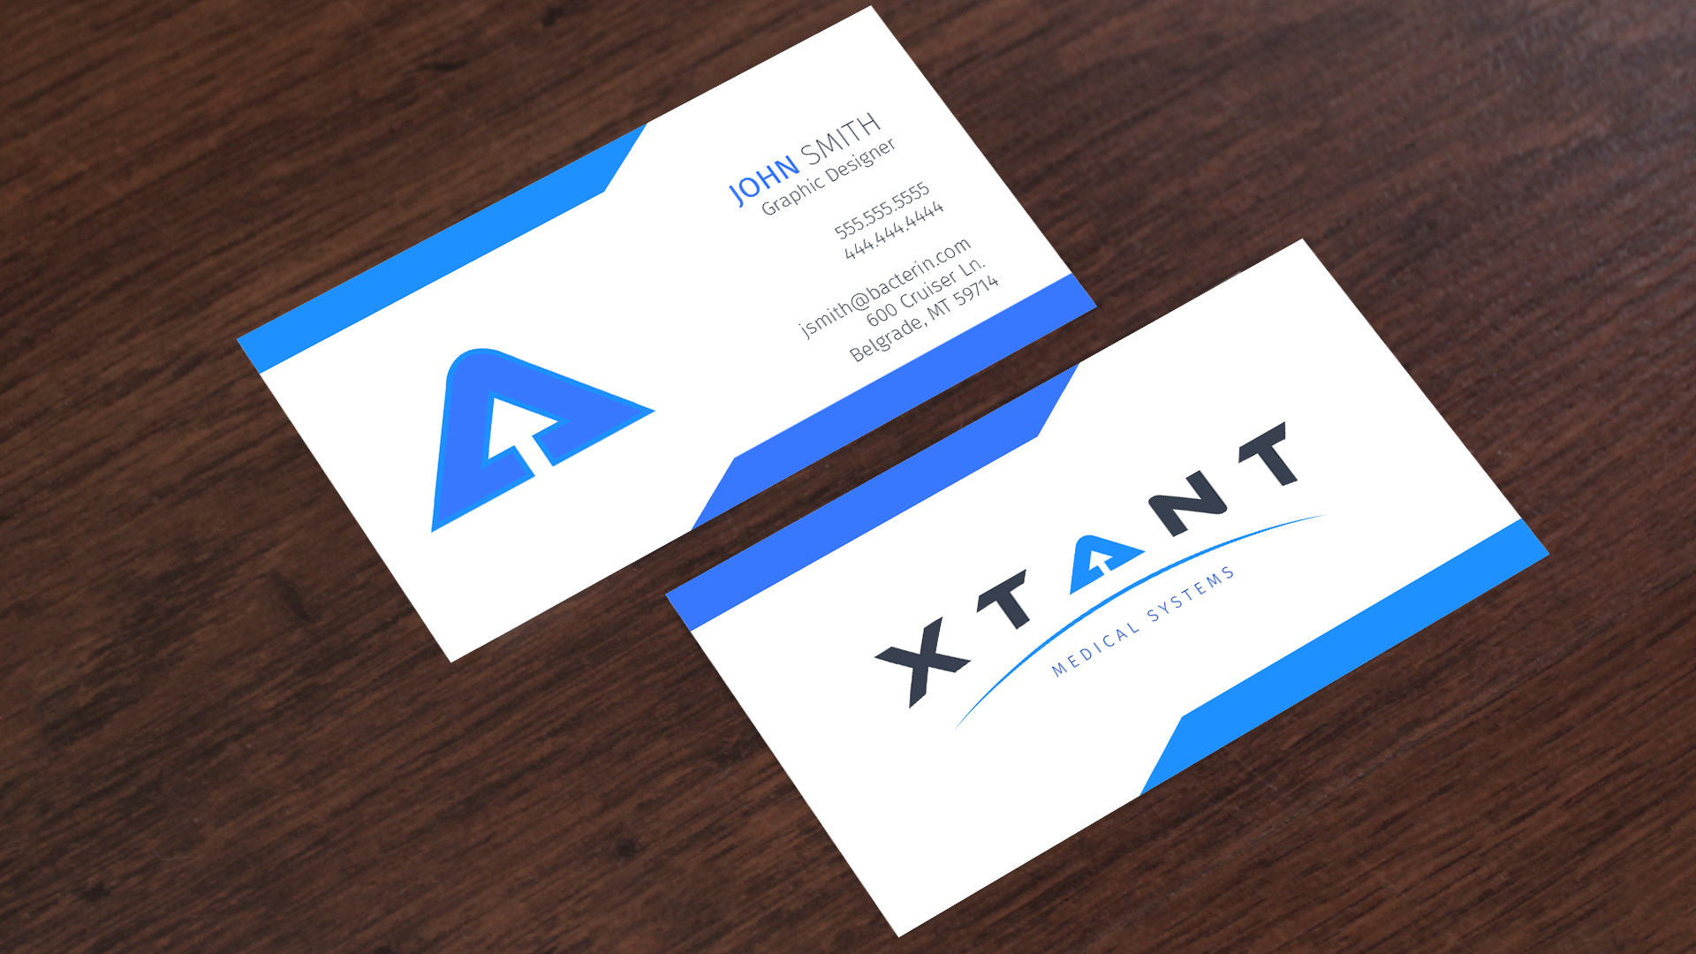

Slide 15
VERSION 2

Slide 16
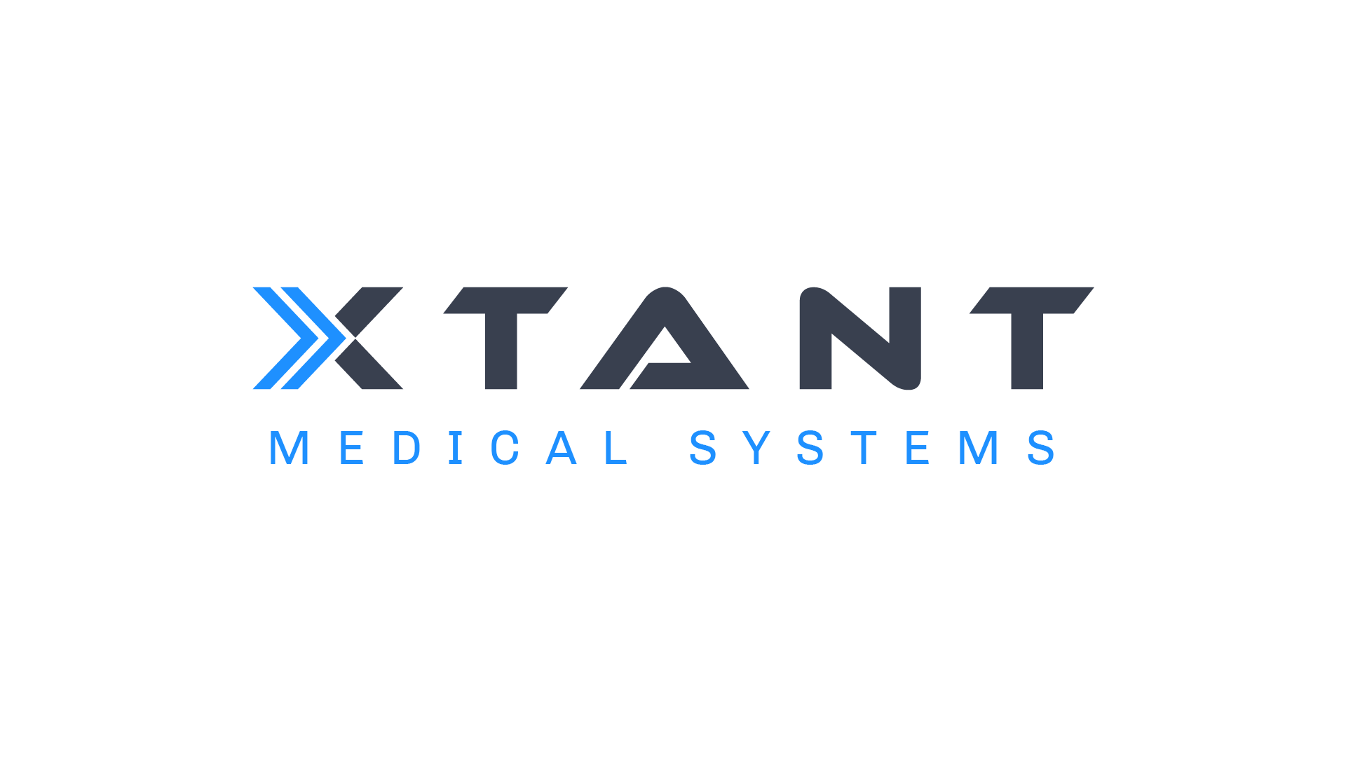
LOGOS
Version 2

Slide 17
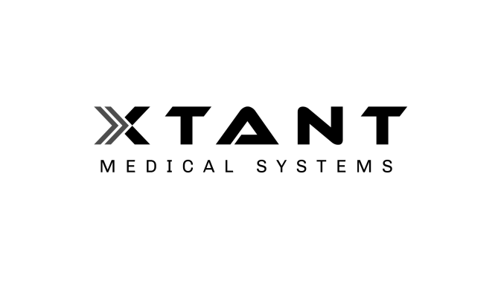
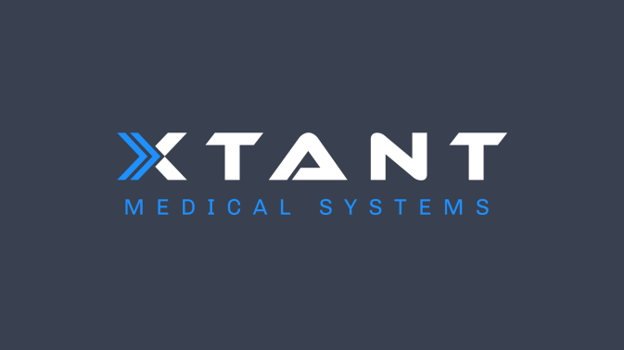
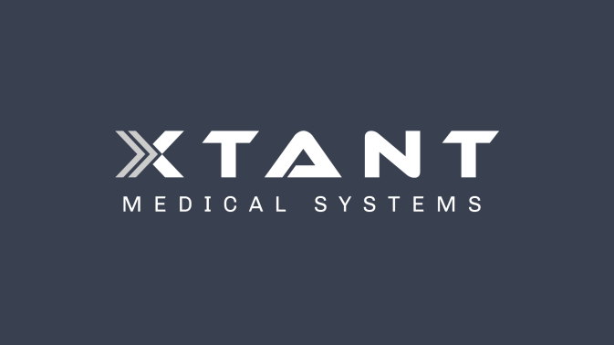
LOGOS
Version 2
Version 2 – Color on Light
Version 2 – Grayscale on Light
Version 2 – Color on Dark
Version 2 – Grayscale on Dark
This iteration shows forward progress and forward thinking. The rectangular balance of this logo makes it very easy to reproduce across all media.

Slide 19
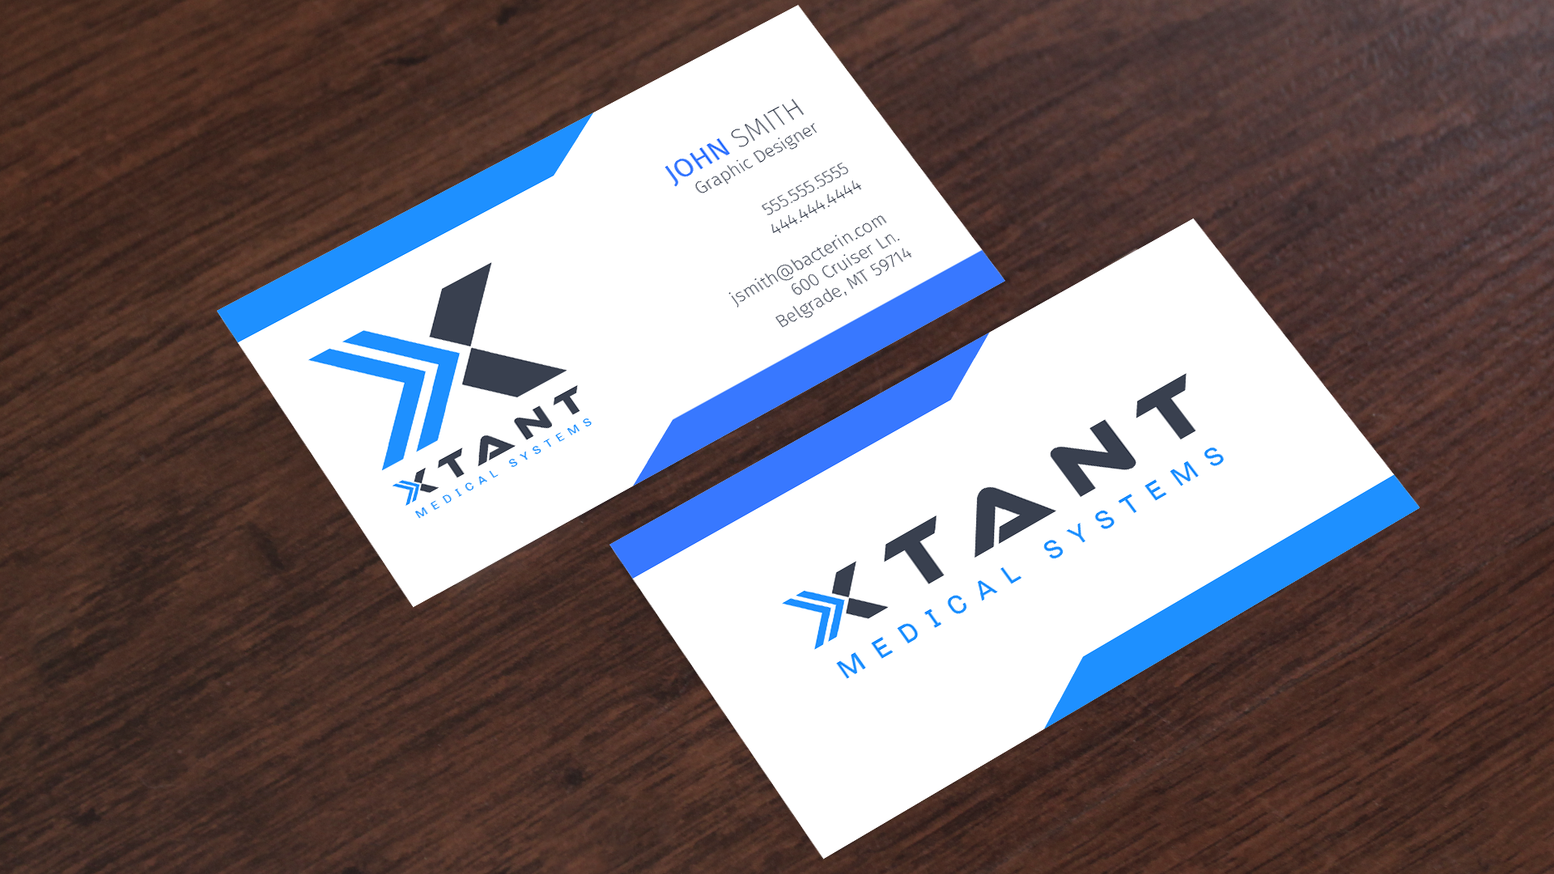

Slide 20
VERSION 3

Slide 21
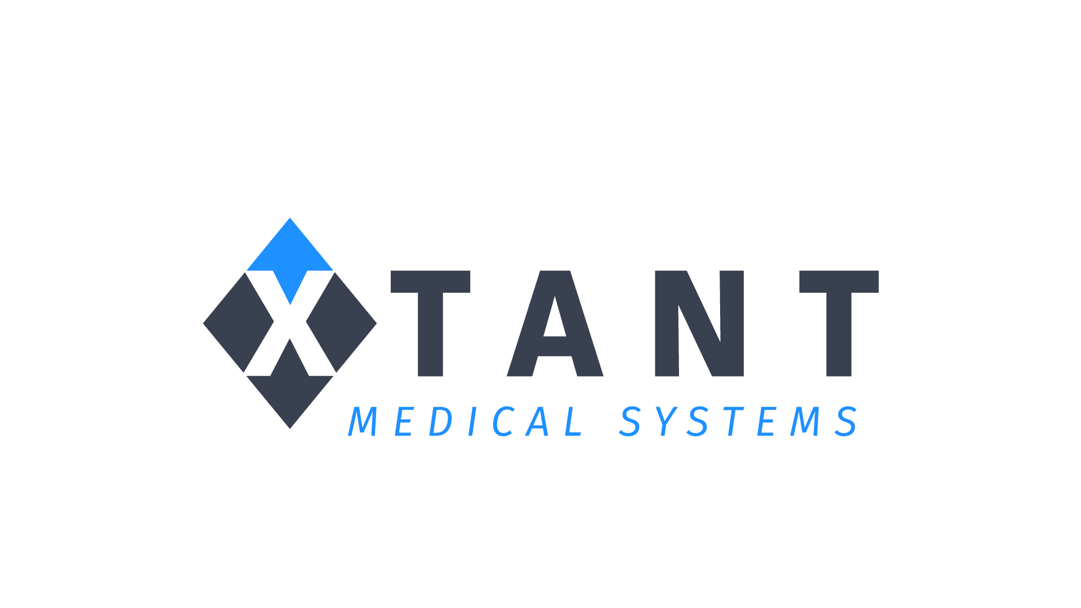
LOGOS
Version 3

Slide 22
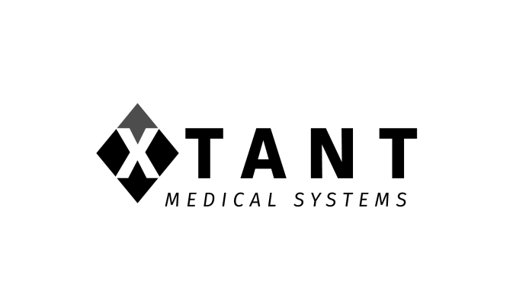
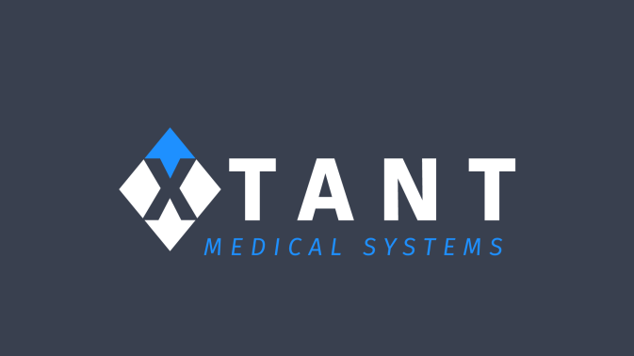
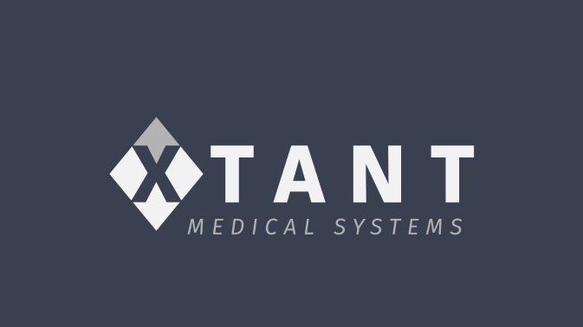
LOGOS
Version 3
Version 3 – Color on Light
Version 3 – Grayscale on Light
Version 3 – Color on Dark
Version 3 – Grayscale on Dark
Similar to the rationale of version 1, this iteration uses the up arrow to portray upward progress and heightened goals and ambtions.

Slide 23
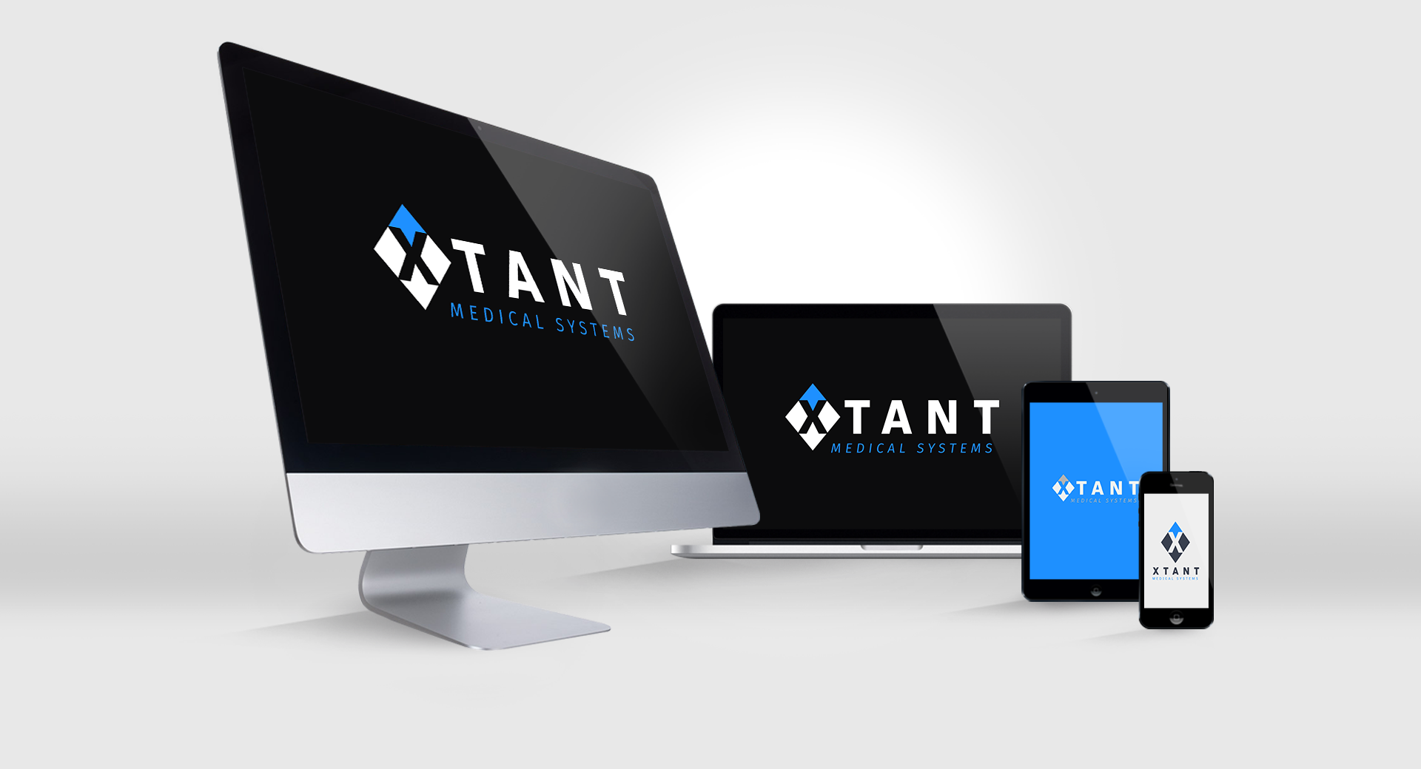

Slide 24
